Slide 1
Phase 4 Project.
Group 2 Members:
Alvin Ng’eno
Elsie Njambi
Ann Wahu
Kigen Tuwei
Mitchelle Mkan

Slide 2
BrandPulse: Decoding SXSW Sentiment
Competitive Intelligence on Apple & Google Tweets
Social Media Sentiment Analysis for Marketing Decision-Making

Slide 3
Business Understanding
Brands invest heavily in SXSW marketing campaigns but lack real-time insight into:
• Audience emotional response
• Competitive brand positioning
• Product features capturing attention
Goal: Provide a data-driven view of Apple vs Google sentiment during SXSW.

Slide 4
Problem Statement
Marketing teams struggle to answer:
• Is our campaign resonating positively?
• How does sentiment compare to competitors?
• What features or stunts are generating positive, negative, or neutral reactions?
BrandPulse provides quantified sentiment and competitive intelligence.

Slide 5
Key Stakeholders
1. Marketing Directors (Apple, Google)
– Evidence-based decisions: amplify or stop campaigns. – Identify real-time audience resonance.
2. Brand Strategy Consultants
– Competitive benchmarking.
– Detect emerging trends and market gaps.
3. CMOs After SXSW
– Post-event analysis for next year’s planning.
– Smarter budget allocation.

Slide 6
Value Proposition
BrandPulse analyzes tweets about Apple & Google from SXSW to deliver:
• Quantified sentiment scores
• Trend detection and topic clustering
• Cross-brand comparison
• Actionable insights for competitive marketing

Slide 7
Dataset Overview
• Data Source: Twitter API / public tweet datasets
• Timeframe: During SXSW event window
• Brands: Apple & Google products and campaigns
• Features: Tweet text, hashtags, timestamp, engagement metrics

Slide 8
Analysis Approach
1. Preprocessing: Cleaning, tokenizing, removing noise.
2. Sentiment Analysis: ML/NLP model to classify tweets.
3. Topic Modeling: Identify emerging themes.
4. Visualization: Sentiment trends & competitive heatmaps.
5. Insights: What people love or criticize.

Slide 9
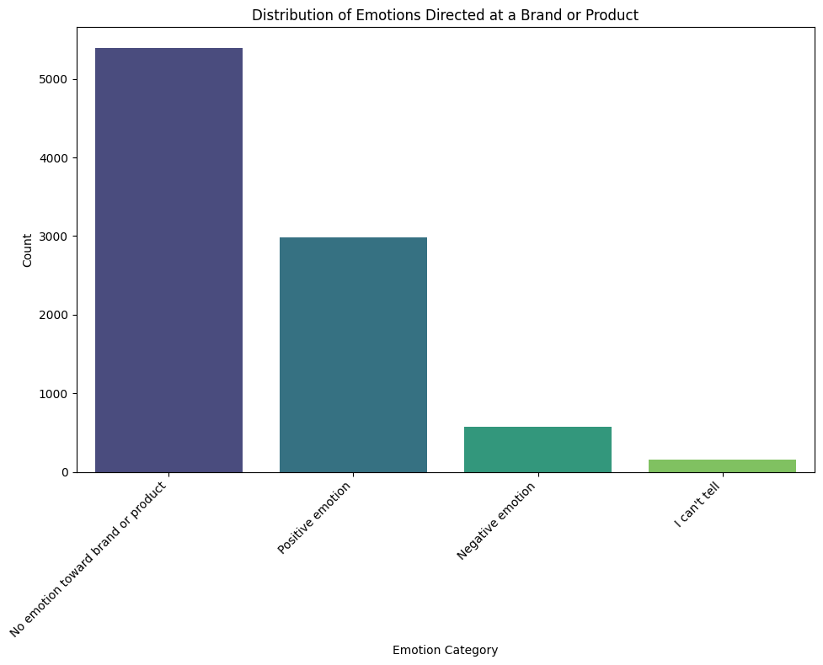
Sentiment Distribution.

Slide 10
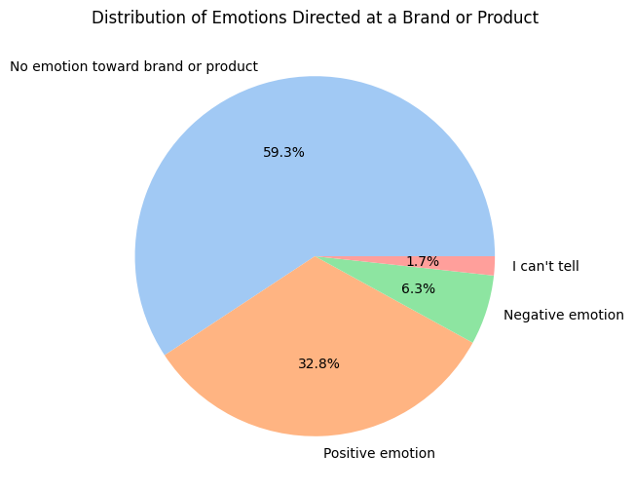
Sentiment Distribution in Percentage.

Slide 11
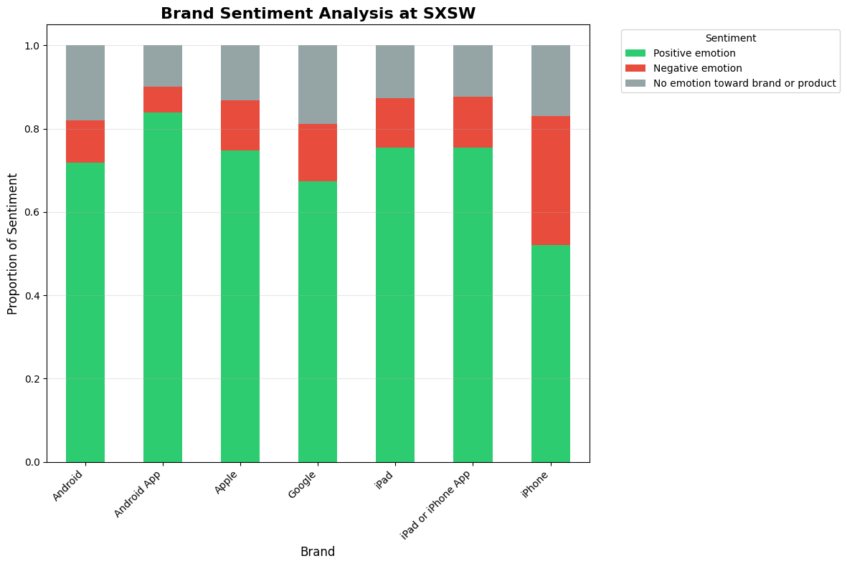
Brand Performance.

Slide 12
Key Business Insights.
Since positive sentiment dominates, brands can leverage this for marketing amplification and customer engagement campaigns.
The concentration of tweets in the mid-length range indicates that content strategies should target concise yet informative messaging to match natural user behavior.
Monitoring tweets for negative sentiment, even if less frequent, is important for brand reputation management.

Slide 13
Strategic Recommendations
For Marketing Directors:
Continue successful strategies
• Apple: Maintain pop-up store approach for major events
• Google: Continue engaging party and event strategy
Address pain points
• Monitor negative sentiment around specific product issues
• Implement real-time social listening for rapid response

Slide 14
CONT…
For brand strategy consultants:
Quantitative competitive analysis
• Use sentiment scores for objective brand positioning
• Identify market gaps and opportunities
2. Real-time campaign optimization
• Implement BrandPulse for ongoing campaign monitoring
• Adjust strategies based on live sentiment data

Slide 15
Conclusion
BrandPulse provides actionable, real-time insights into Apple & Google brand sentiment.
Empowers marketing leaders with data-driven decisions for competitive advantage.

Slide 16


Slide 17
